Slide 1
Big 5 personality Big 5 personality clustering based on K-means algorithm
Group members:
Ammar Khan
Moazzan Sabir
Faisal Ali
Umer Abdul khaliq

Slide 2
Intro
Human behavior is of tremendous importance of tracking behavior from daily life behavior to tracking possibility of diseases.
It is currently a hot topic in research domains to enhance user experience based on their behavior.
World wide web needs some sort of markers to suggest content based on user personality type.
We can segregate users based on their personality type by using Big 5 Personality model.

Slide 3
Big 5 traits
Extraversion -- Outgoing, Adventure Seeking
Openness -- Change seeking, Open to new ideas
Neuroticism -- Possession and handling of Negative emotions
Conscientiousness – Order in life, determination to perform a goal, duty
Agreeableness – Easy going, easy to convince

Slide 4
Methodology
Collect answers dataset for Big 5 Personality.
Clean dataset. (remove empty or invalid responses)
Count scores for each trait.
Normalize values for scale and find k (5 in the project)
Cluster formation using K-Means

Slide 5
Dataset
Dataset taken from https://ipip.ori.org/newBigFive5broadKey.htm.
5 inventory scale.
50 questions
1013481 responses
5000 used for cluster formation

Slide 6
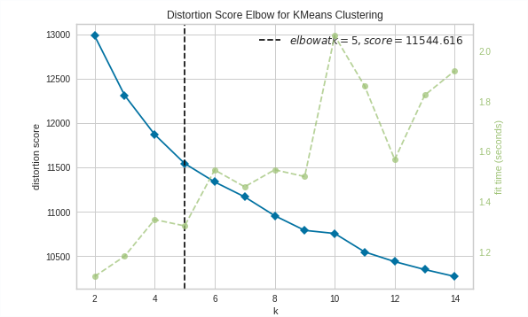
Finding value of k
Sample of 5000 responses were normalized using MinMaxScaler
Range for values selected (0-1, float)
KElbowVisualiser used to find optimal value of K between 2-15

Slide 7
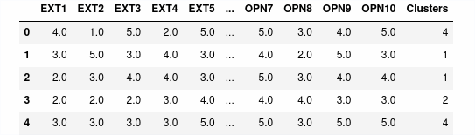
Cluster formation
Value of K was found to be best at 5
Using K-Means to form clusters.
Distance between users was calculated based on distance vector method

Slide 8
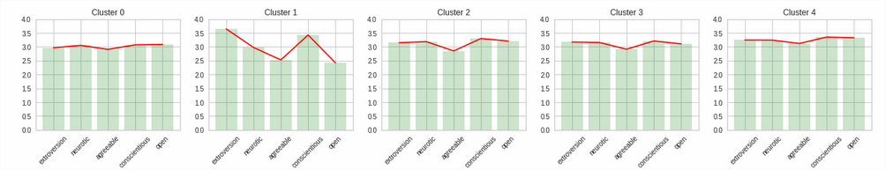
Cluster Mean score
Cluster 0 represents users with above average score in each trait
Cluster 1 represents users with very high score in Extraversion and conscientiousness but low score in openness
Cluster 2 represents low score in agreeableness but above average score in all other traits
Cluster 3 represents a peak with conscientiousness but relatively less lower score in agreeableness
Cluster 4 represents average scores in extraversion and neuroticism and average score in agreeableness and openness but relatively lower score in openness

Slide 9
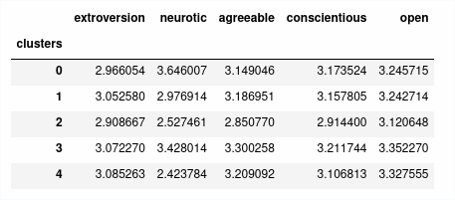
Cluster average scores for each trait

Slide 10
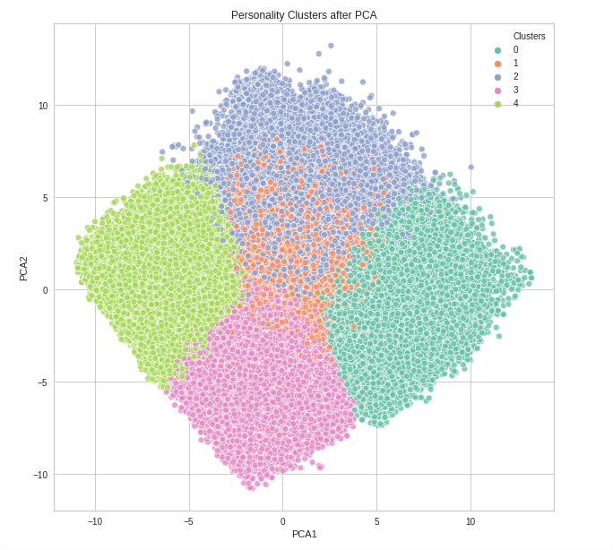
Trait Dispersion

